Slide 1
BULK EMAIL AGGREGATOR
Guide Name: Dr. Veena S Vijaykumar R Pai – PES1201702013
Chairperson, Dept. of CA Ayush Pratyay – PES1201702164
PES University Subham Singh – PES1201801830

Slide 2
ABSTRACT
Bulk Email Aggregator is a web application that is used to provide a paid service to the end user who is CRM, which will enable them to send bulk emails for collecting feedback of their own electronic product.
With the use of Google OAuth authentication, we have enhanced the authentication in the app.
Our service will be provided on usage of assigned credit points to user.

Slide 3
INTRODUCTION
Send bulk emails to a big list of users for the purpose of collecting feedback.
Full gamut of features including everything from authentication to email handling.
Handle credit cards and receive payments from the users with Stripe gateway. Stripe is payment gateway offered by an US Company which is free for students for development.
We will also be enhancing the authentication in our app with the use of Google Oauth authentication.

Slide 4
LITERATURE SURVEY
Electronic product companies assign the task of collecting feedback to the CRM’s.
Companies like Croma send text messages to customers to collect feedback where they have to send individual messages to each and every person.
Therefore, with this system we are trying to send emails to collect feedback from the customers who had purchased products from their company much more efficiently and getting abstract of performance of the electronics in the market.

Slide 5
TOOLS AND TECHNOLOGIES
Frontend: React.js v16.x
Backend: Node.js v11.x
Database (NoSQL): MongoDB Atlas
Cloud Deployment: Heroku Deployment
Authentication API: Google OAuth
Payment Gateway API: Stripe
Other Technologies used: Twilio SendGrid, Git and GitHub

Slide 6
USERS
CRM
Customer Relationship Manager
Customers
Who purchase products from different electronic companies.

Slide 7
FUNCTIONAL REQUIREMENTS
CRM Signs Up via Google OAuth.
CRM Pays for email credits via Stripe.
CRM creates a new campaigns.
CRM enters list of emails to collect feedback.
Application send emails to list of customer.
Customers click on the link provided in the email to send feedback.
Application will tabulate feedback received.
CRM can see list of all feedback responses.
Logout

Slide 8
NON – FUNCTIONAL REQUIREMENTS
Availability
Maintainability
Performance
Supportability

Slide 9
MODULES
Google Authentication
Credit Points
Payment Request/ Response
Creating Feedback and Sending
Feedback Collection
Visualization of Feedback

Slide 10
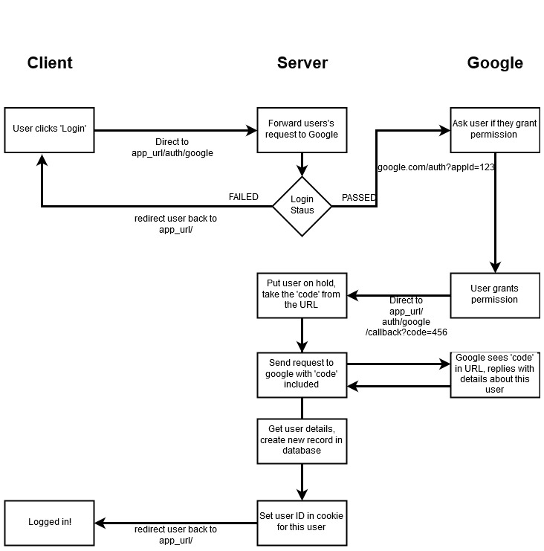
Google Oauth Flow Diagram

Slide 11
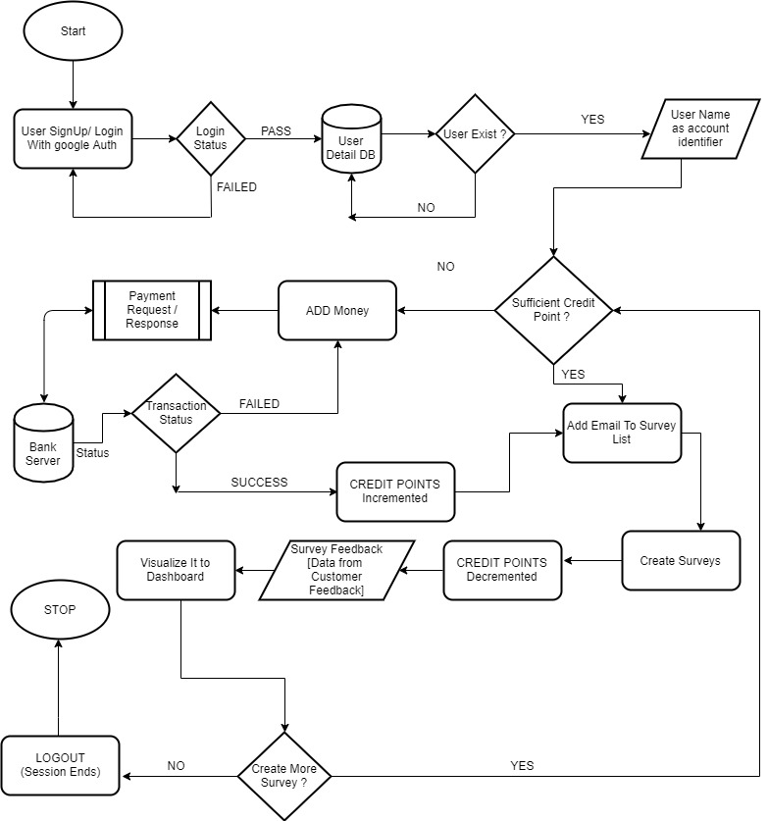
Flow Diagram Of System

Slide 12
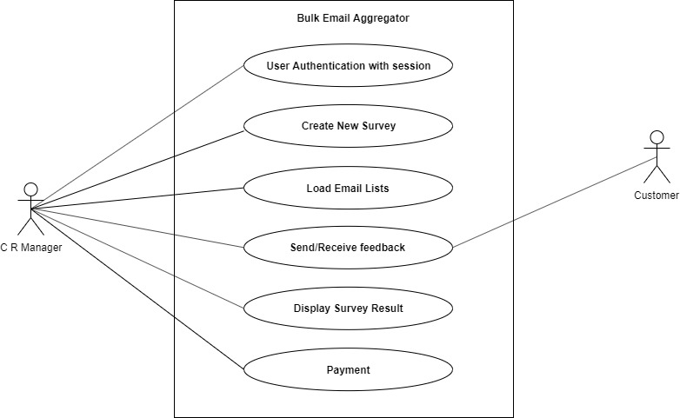
Use Case Diagram

Slide 13
Document Structure
"user":{
_id : ObjectId(""),
googleId : "String Type",
__v : "Integer Type",
credit : "Integer Type"
}
“feedback":{
_id: ObjectId(""),
yes: "Integer Type",
no : "Integer Type",
title : "String Type",
subject : "String Type",
body : "String Type",
recipients: "String Array Type" {
index : "Integer Type",
responded : "Boolean Type",
_id : ObjectId(""),
email : "String Type"
},
_user : ObjectId(""),
dateSent : "Date Time Type",
__v : “Integer Type”
}
"recipient" : {
email : "String Type",
responded : "Boolean Type"
}

Slide 14
HERE the live deployment of Web App
https://sheltered-reef-50053.herokuapp.com

Slide 15
THANK YOU

